Slide 1
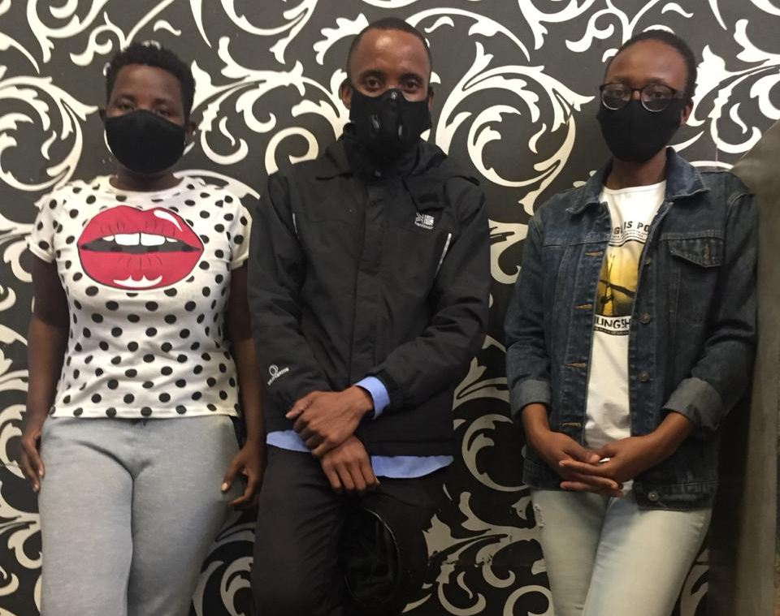
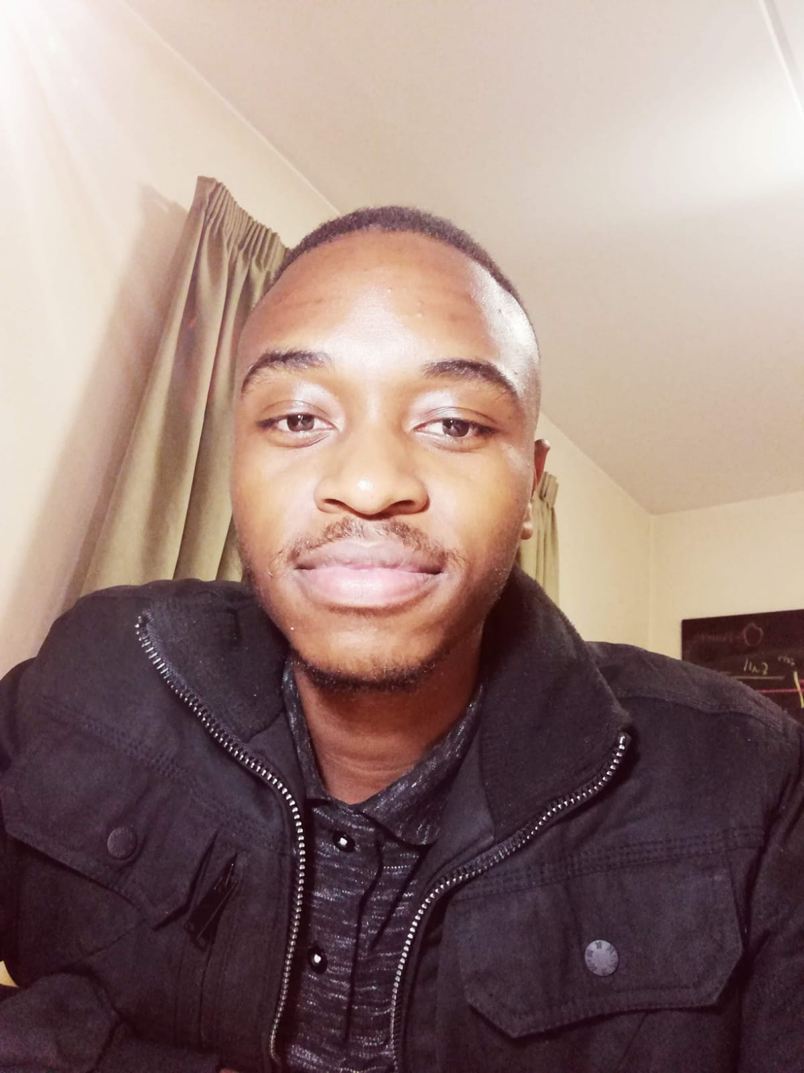
SDG 11: SUSTAINABLE CITIES AND COMMUNITIES
e-waste lights
e-waste lights
TEAM LESEDI: SIBONGILE MONGADI, MLAMULELI MOYO, LINDOKUHLE TSHUMA, DANIEL CHIKAVA

Slide 2
e-waste lights
Welcome to a better world

Slide 3
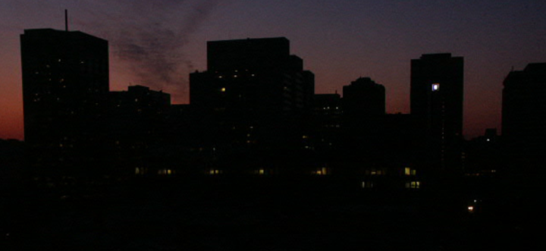
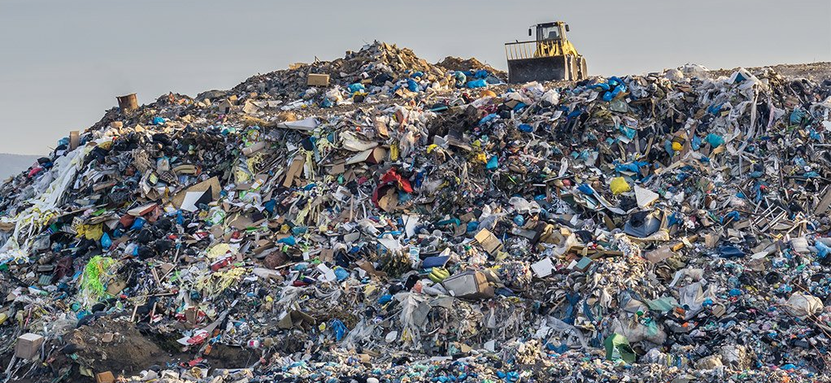
THE PROBLEM _____________________
1. Landfill sites
: Shortage of landfill space
: 2,5 kilograms of waste produced by a person per day
2. Crime during electricity cuts
: 469 224 property related crimes
TEAM LESEDI

Slide 4
SOLUTION
Waste collection
Collect sorted waste from households, co-operate
Pay households, co-operate spaces for waste sorting
Waste Recycling
Sell other sorted waste material
Waste to Production
Use filament to 3D Print streetlights
Recycle plastic to 3D Printing filament (PETG)
Power streetlights with renewable energy
SMART COMMUNITIES
TEAM LESEDI

Slide 5
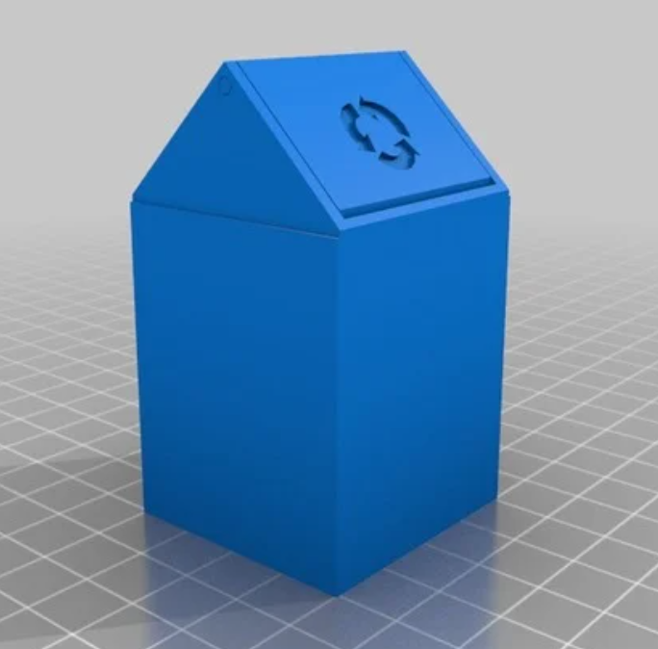
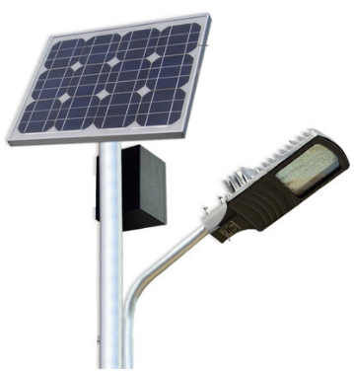
PRODUCT
WASTE SORTING & TRACKING
WASTE TO PRODUCT
STEP 2
RECYCLING
STEP 3
STEP 1
Household bins: every citizen responsibility
Waste tracking and fun facts app
Reward for sorting waste
Use recycled material to 3D Print streetlights
Solar powered
TEAM LESEDI

Slide 6
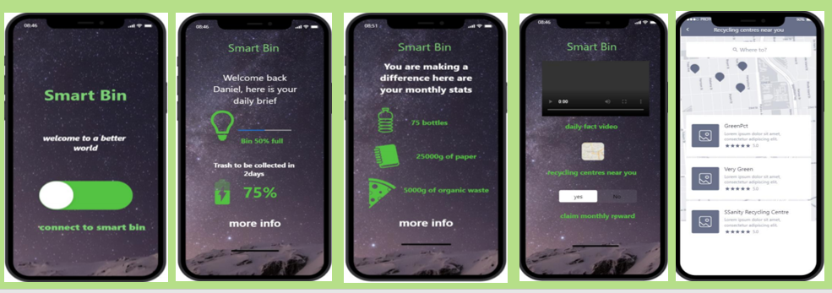
HOW IT WORKS
SMART BIN & WASTE TRACKER APP
TEAM LESEDI

Slide 7
3D PRINTED SOLAR POWERED STREET LIGHTS
TEAM LESEDI

Slide 8
BILL OF MATERIALS
PROTOTYPE COMPONENTS | QTY | COST
3D PRINT | R60/hr | R720
ARDUINO BOARD | 1 | R300
WEIGHT SENSOR | 4 | R208
LED | 1 | R30
SOLAR PANEL | 1 | R51
BATTERY | 1 | R116
BATTERY HOLDER | 1 | R19
BREADBOARD | 1 | R30
JUMPER WIRES | 1 | R28
DUSTBIN | 1 | R80
LCD DISPLAY | 1 | R243
TOTAL |  | R1 825
TEAM LESEDI

Slide 9
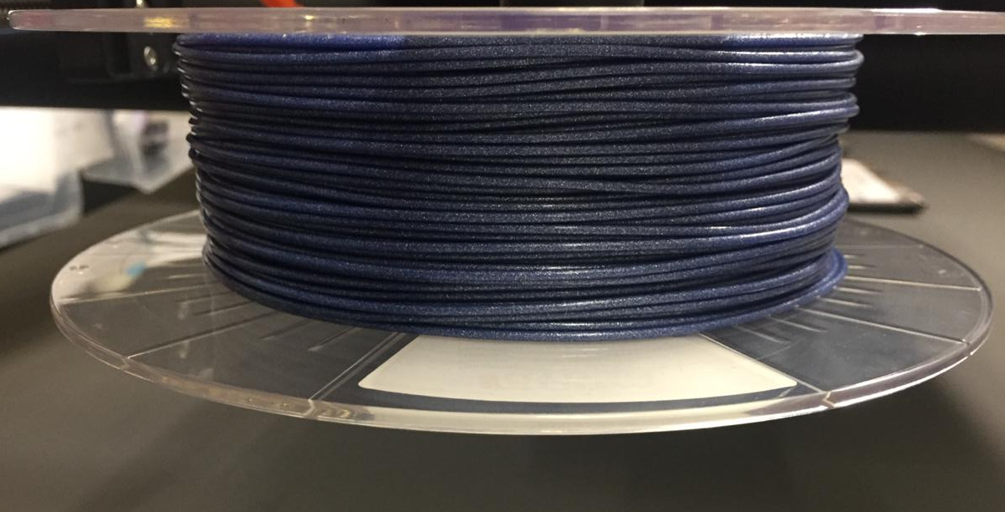
BUSINESS MODEL
REUSE
3D PRINT
RECYCLE
TEAM LESEDI

Slide 10
COMPETITORS
STREETLIGHT MANUFACTURES | MATERIAL | COST
VIDERE | METAL | R6 831
MISOLAR | METAL | R9 371
SOLARLIGHT.CO.ZA | METAL | R10 042
e-waste lights | PLASTIC | R4 000
TEAM LESEDI

Slide 11
SDGs
Project aim:
Other solved SDGs:

Slide 12
TEAM LESEDI

